Slide 1

Vocabulary in Reading Study
(VIRS)

Slide 2
Our Team
Capstone 2
Evers Perez
Kendy Megene
Keiss De Los Santos
Kyle Zimmer
Jose Orozco
Mentor: Eric Dwyer
Instructor: Dr. Masoud Sadjadi, Florida International University
Team Leader
Evers Perez

Slide 3
The Problem
English Language Learners (ELL) constantly face a challenge:
Not having an all-encompassing practical solution to learning vocabulary.
It is difficult to find options for ELL and their educators that allows them to:
Measure the difficulty level of text, which can either challenge or discourage the learner.
See definitions of words in a text that they are interested to learn.
Chose words they want to focus on based on categories such as frequently used words.

Slide 4
What is VIRS?

Slide 5
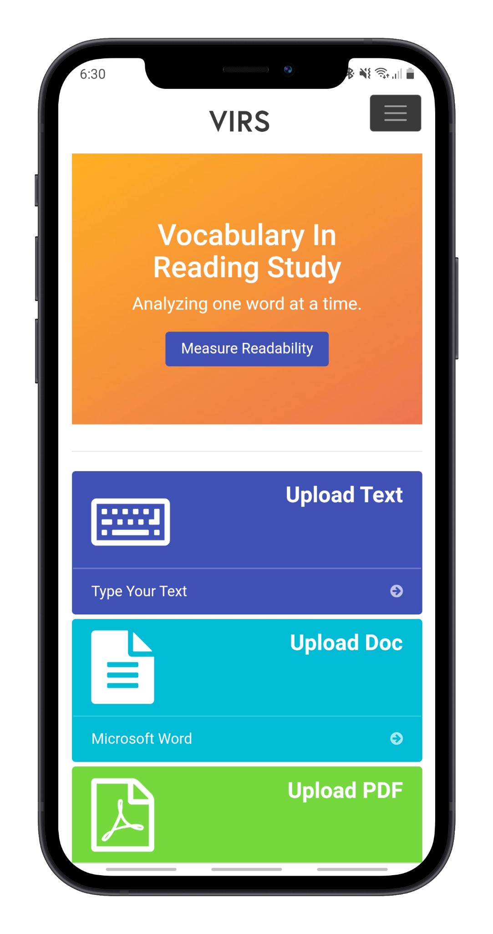
VIRS is a web application that...
Analyzes the user’s upload document can categorized the words by difficulty
Allows the user to easily view the definition of words
Pinpoint words that they would like to focus on based on their frequency and category
Assess their learning through vocabulary quizzes

Slide 6




Technologies
Angular Model View Controller is used for the front end.
Backend is written in Java.
MySQL is used as the database and the data queries are auto generated by Spring Data JPA.
The application is deployed on AWS elastic beanstalk.

Slide 7
Website Overview
Page | Functionality
Home page | Greets the user. Gives option to upload a file to be analyzed
Analyze Text: Enhanced Text | Color codes words based on difficulty.
Analyze Text: Statistics | Provides an in-depth analysis on the difficulty of the text and frequency of certain words.
Word Search | Gives learners a list of words that they should learn and allows them to easily see the definition.
iTranslate | Translates a given text to a number of different languages
Register/User Recovery | Create an account and retrieve lost credentials.

Slide 8
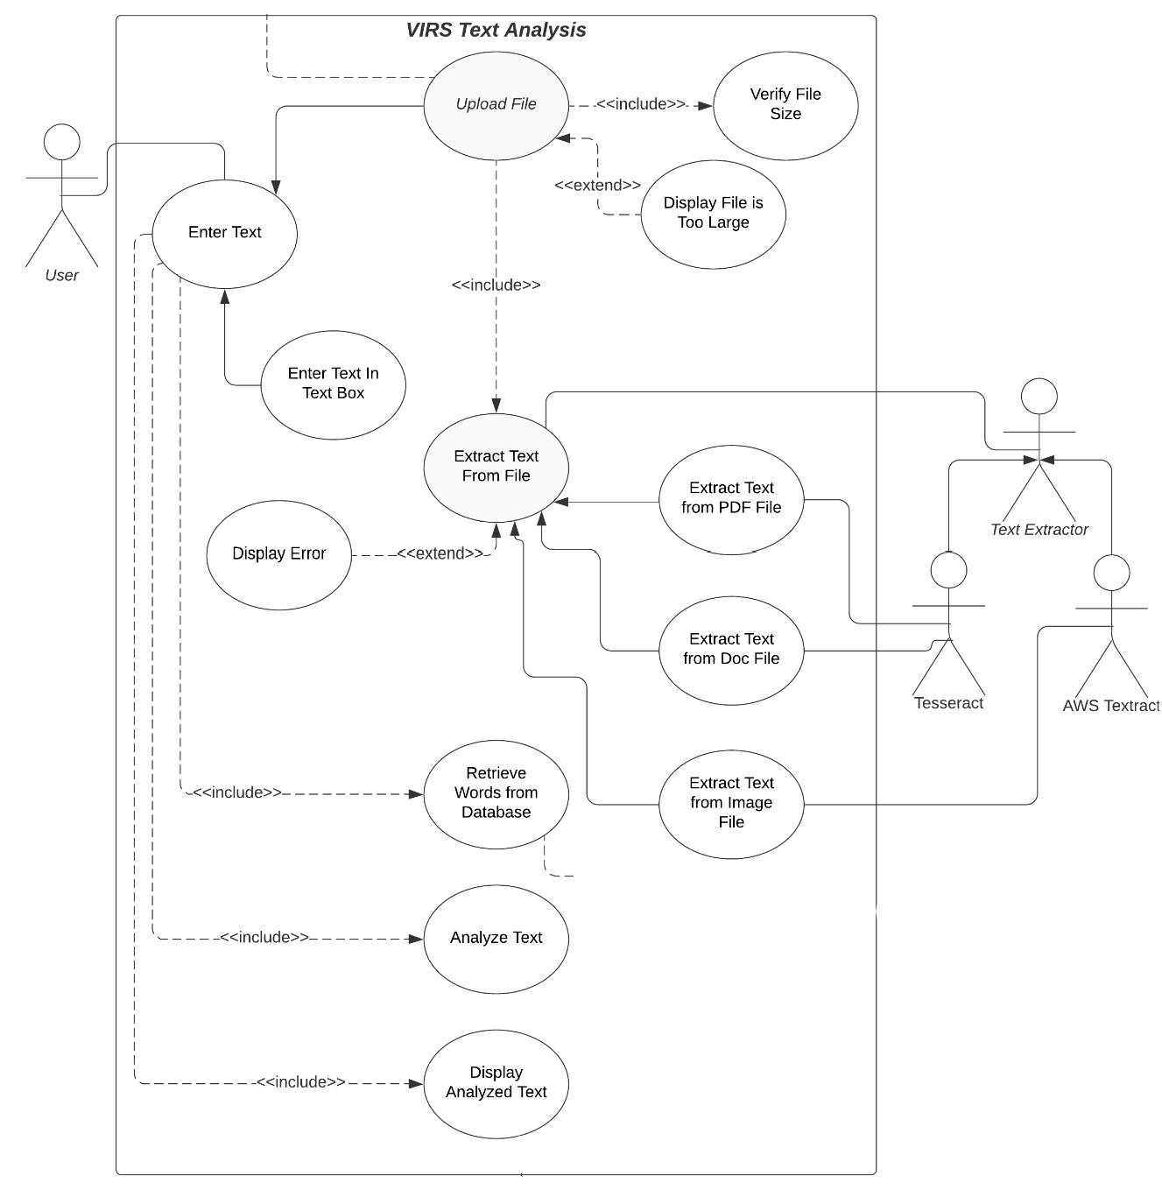
This is how the website functions for text analysis.

Slide 9
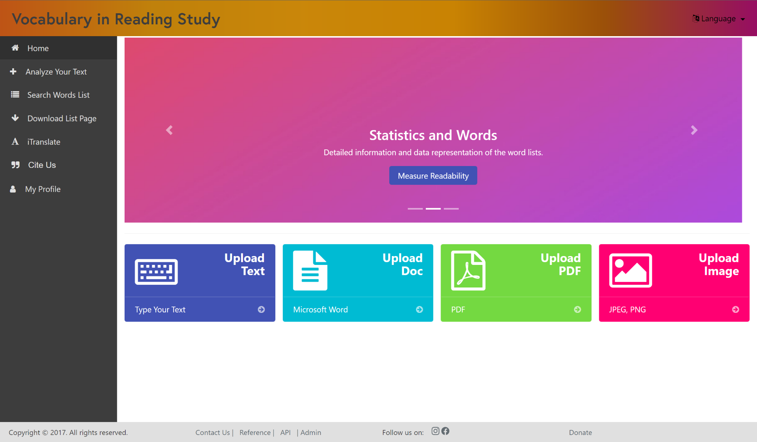
Home Page

Slide 10
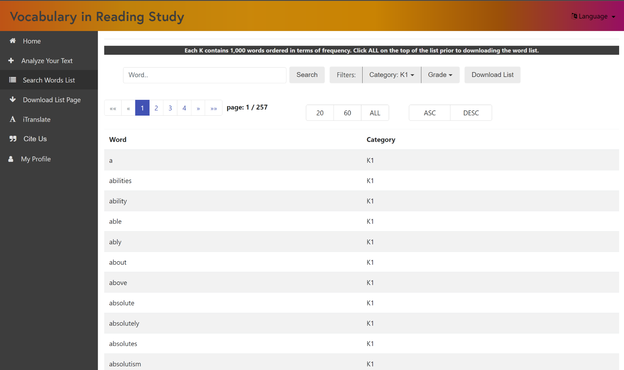
Word Search

Slide 11
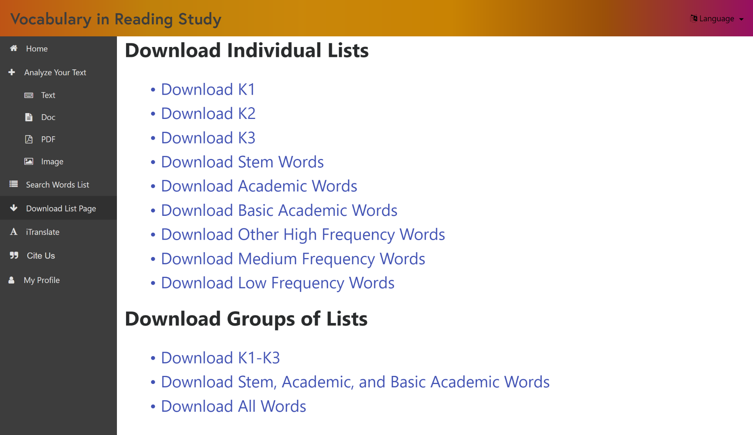
Download Words List

Slide 12
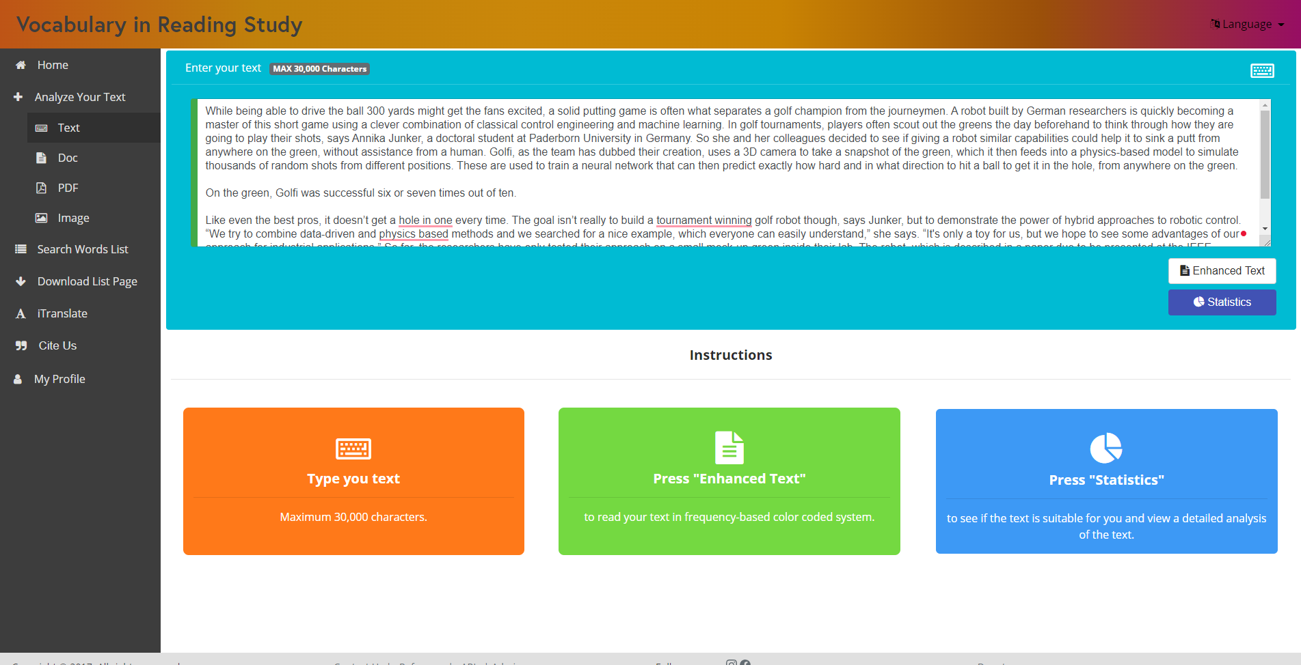
Analyze Text

Slide 13
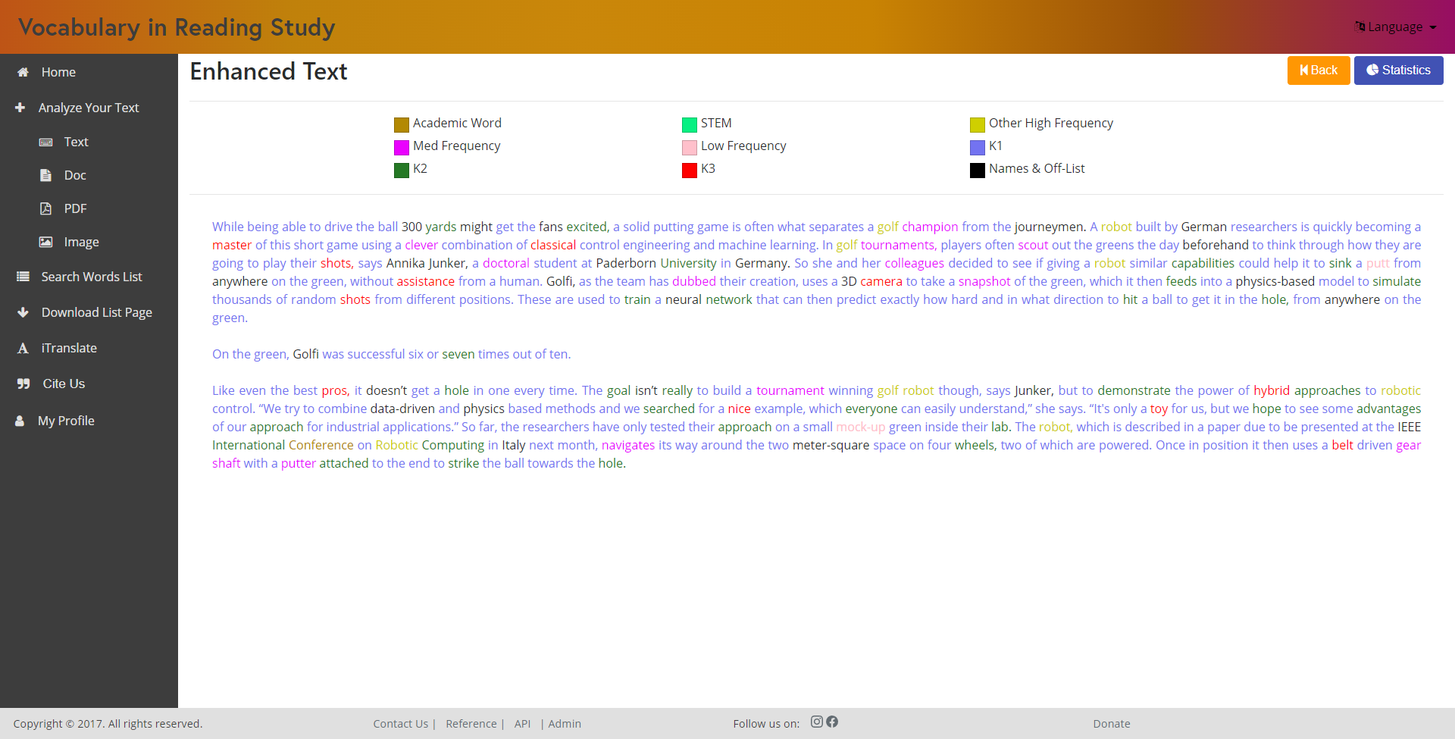
Enhanced Text

Slide 14
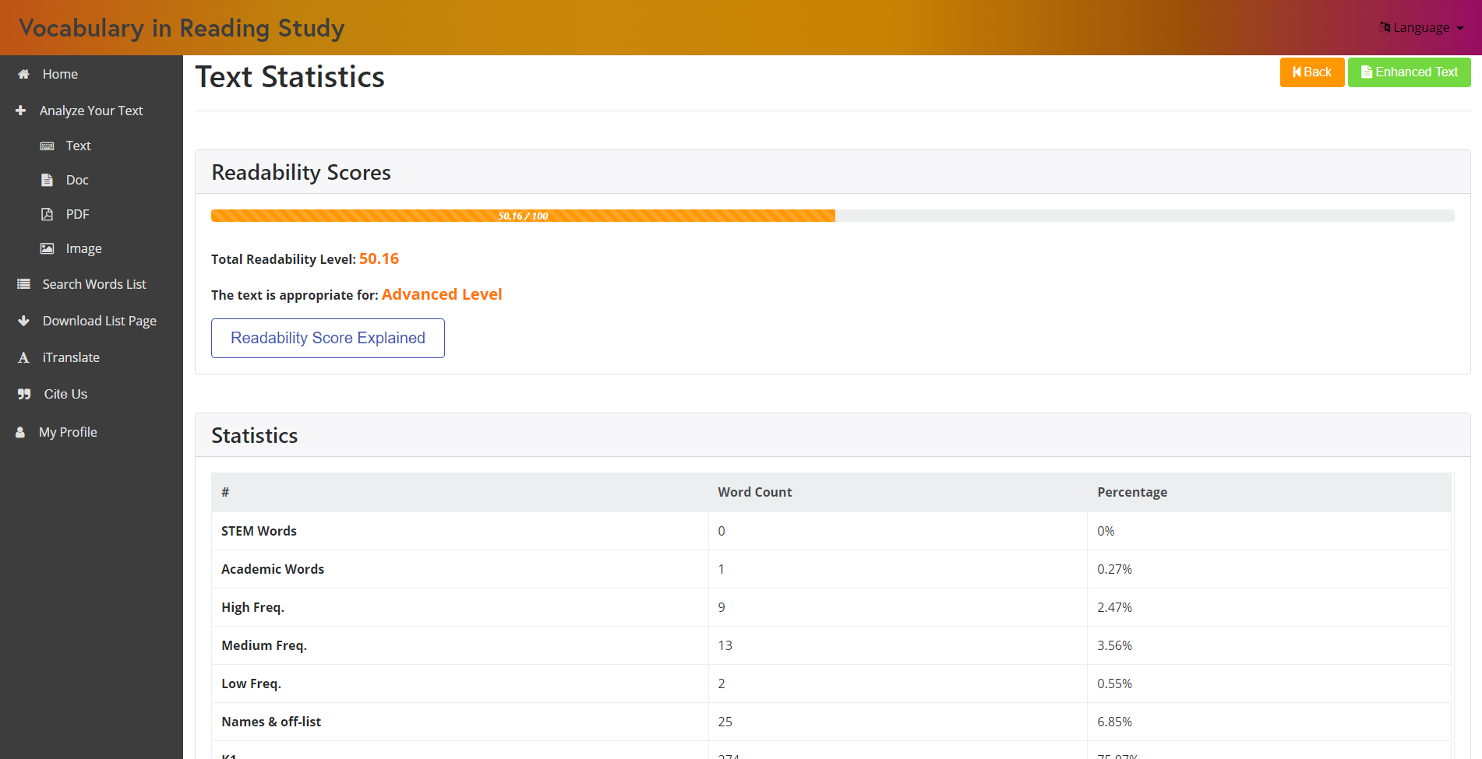
Text Statistics

Slide 15
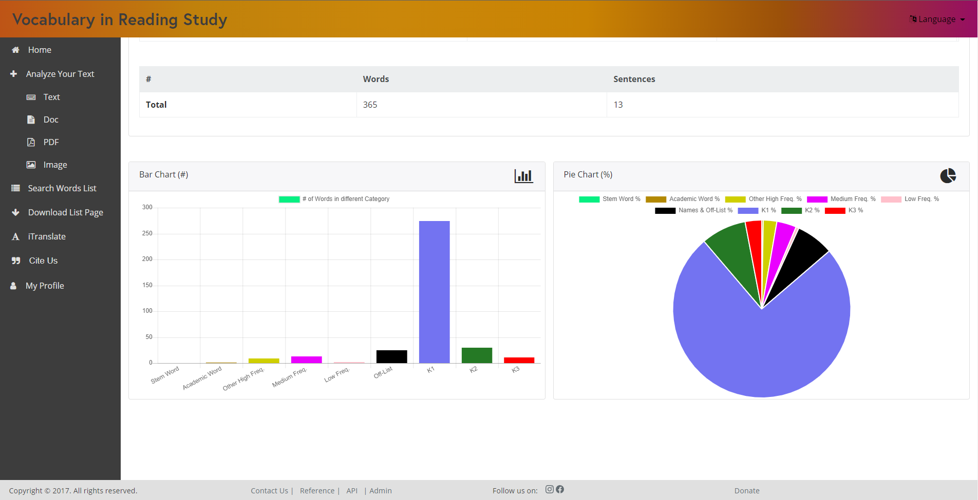
Text Statistics

Slide 16
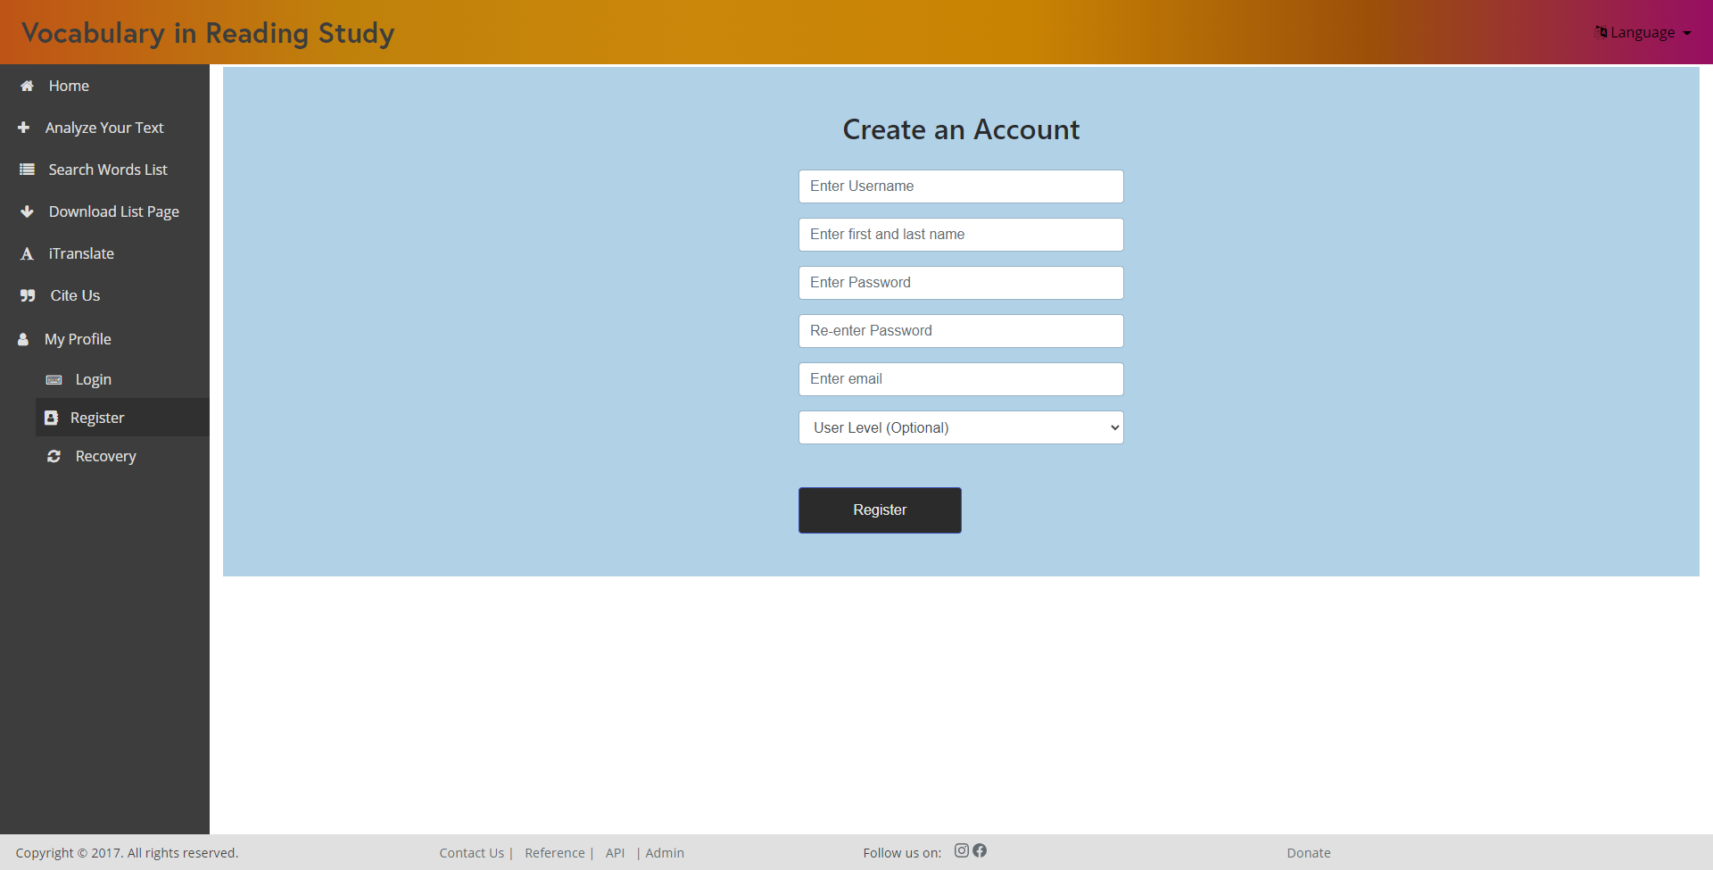
Register

Slide 17
Fixed
Length of characters left to translate

Slide 18
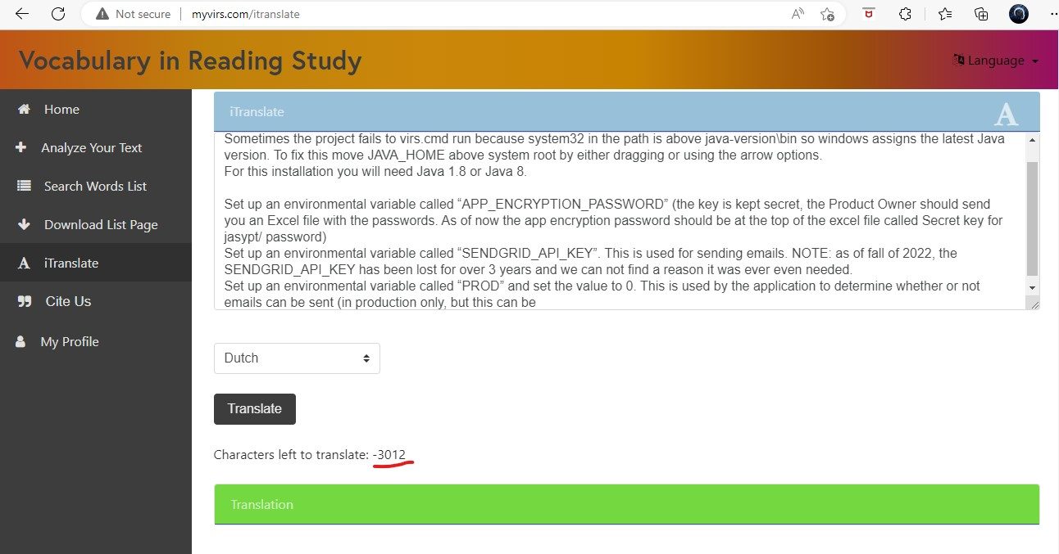
Problem – Counter decreasing without reset

Slide 19
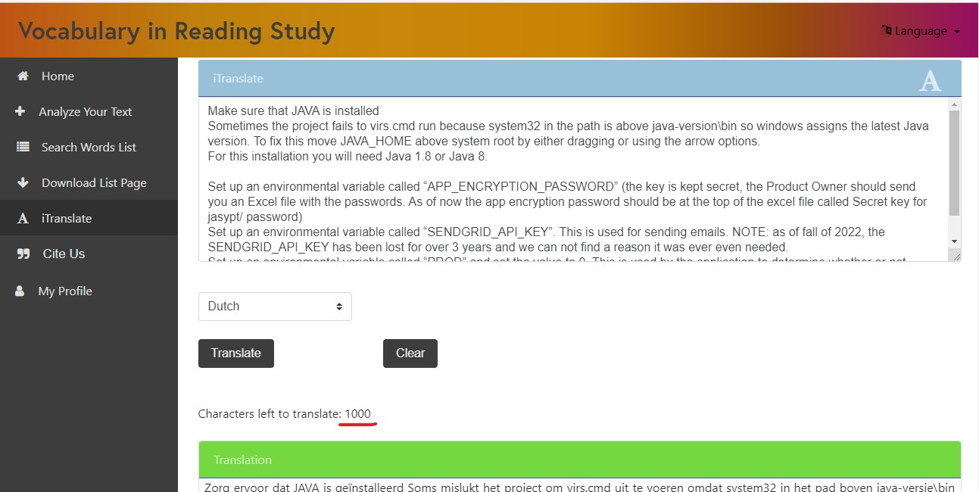
Solved - Current System

Slide 20
Fixed
Hyphenated words

Slide 21
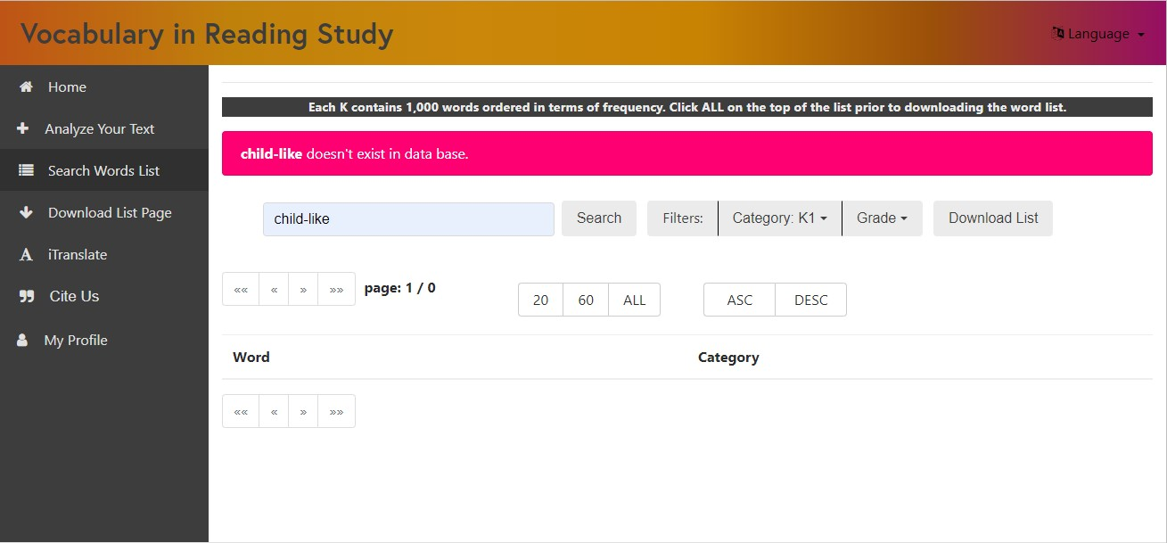
Problem – Hyphenated words not recognized

Slide 22
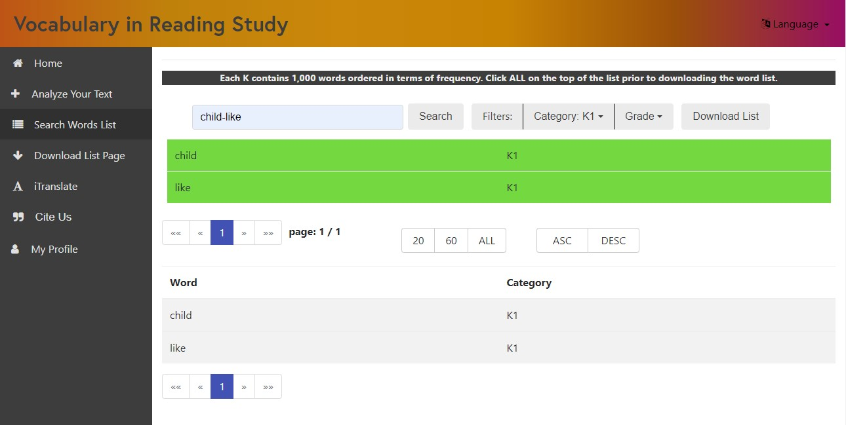
Solved - New System

Slide 23
Fixed
OCR on image processing

Slide 24
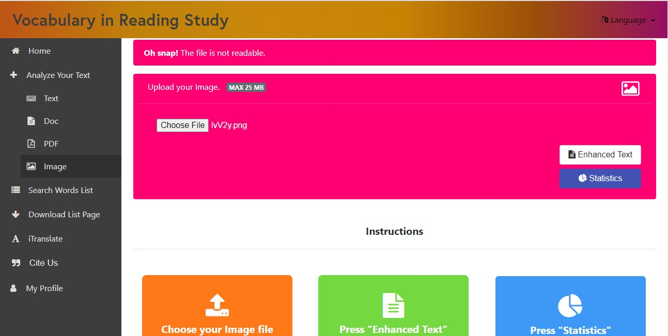
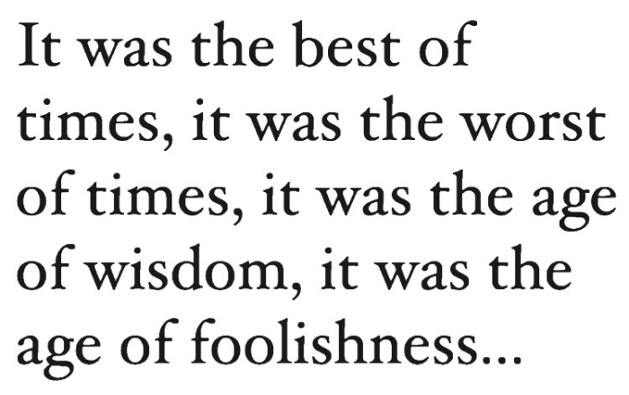
Problem – OCR not working when uploading images
Text image

Slide 25
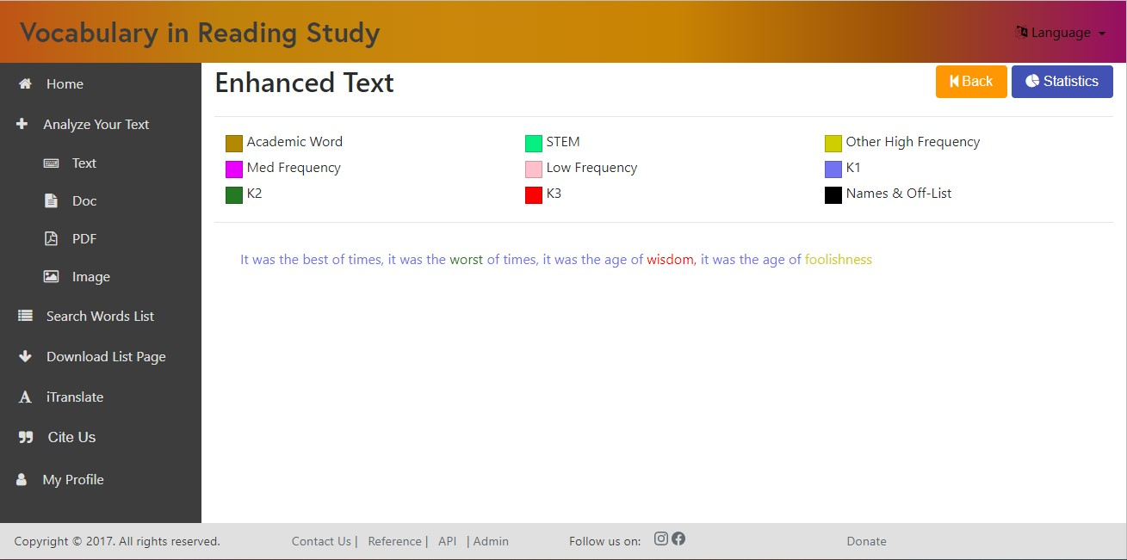
Solved - New System

Slide 26
Fixed
Grade Levels

Slide 27
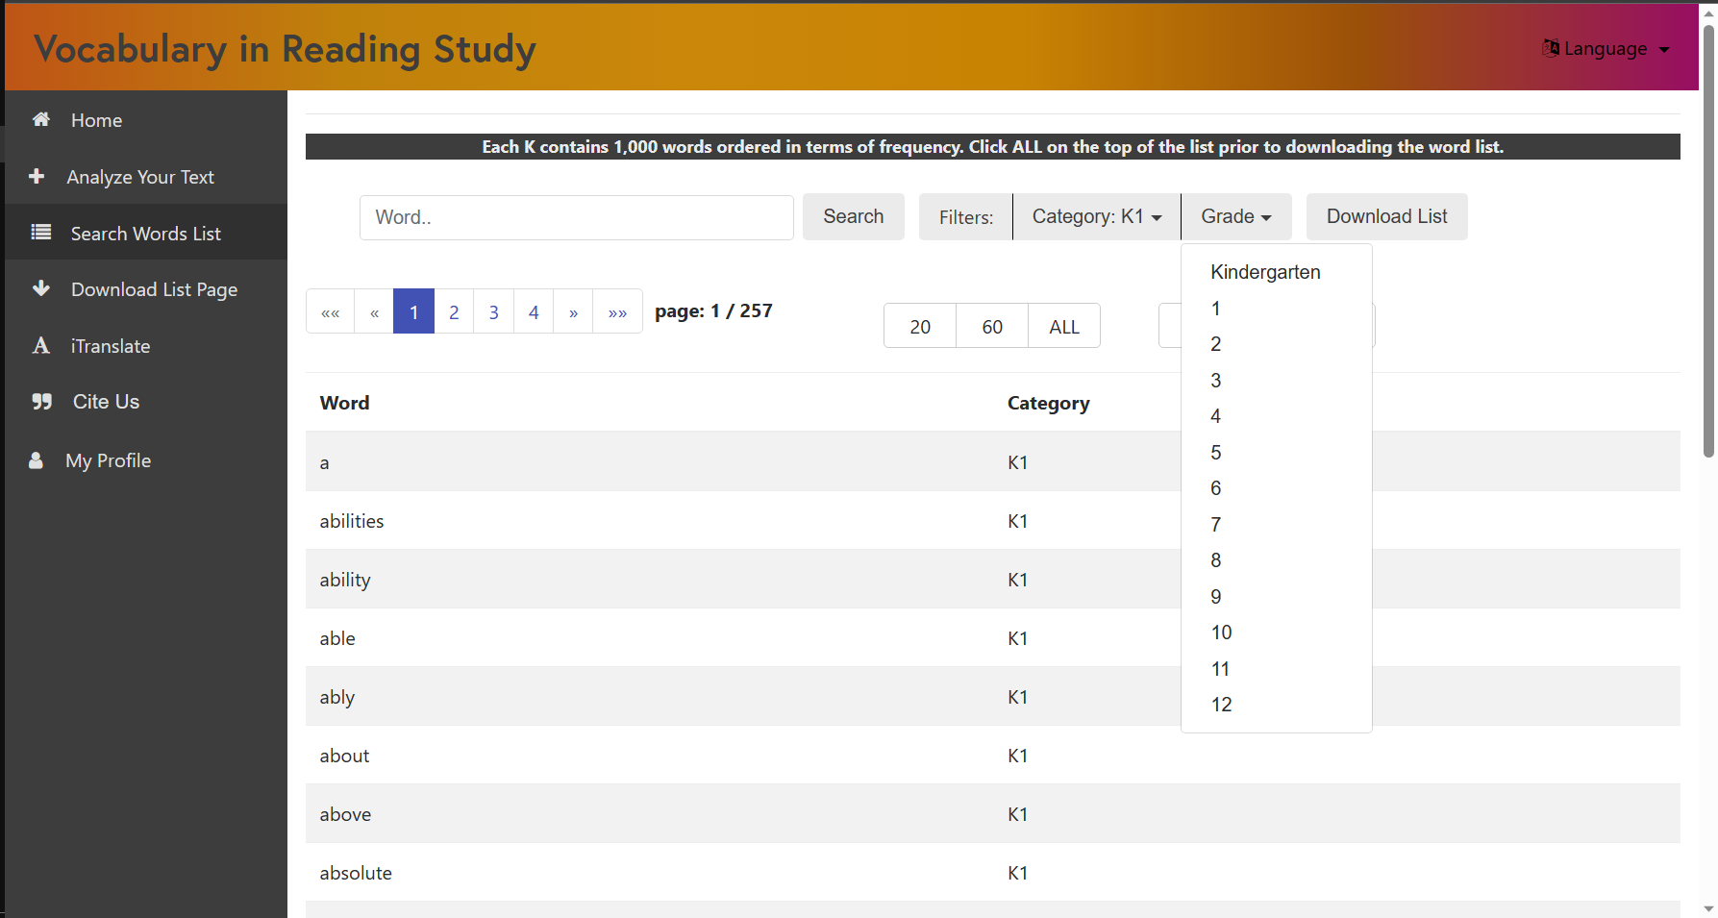
Problem – No sorting by Grade Level
No functionality on selecting grade level.

Slide 28
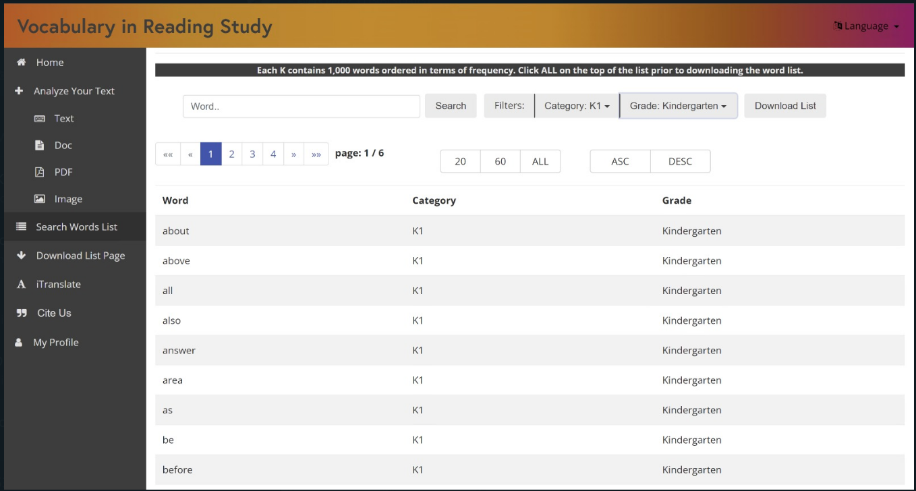
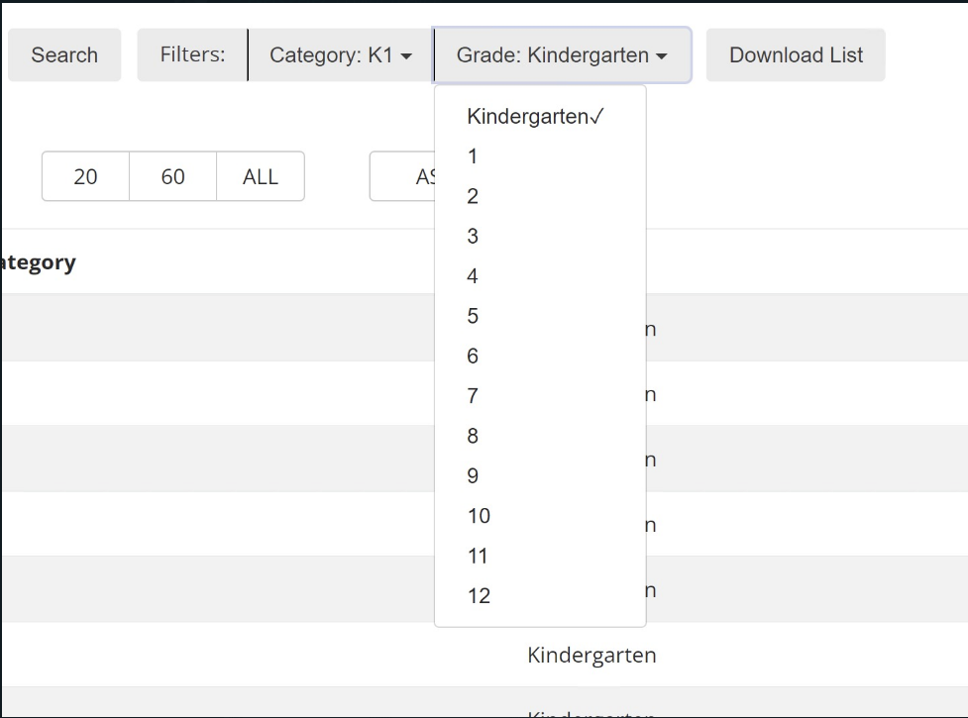
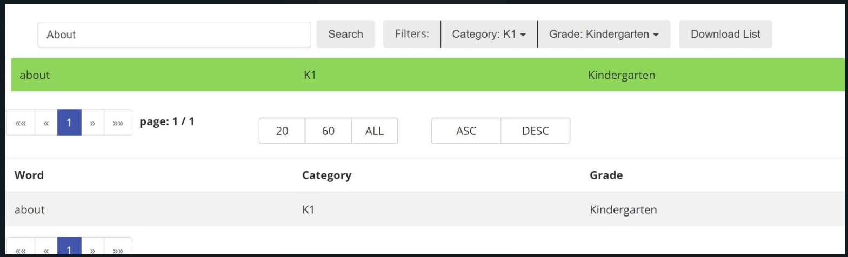
Solved - New System

Slide 29
LIVE DEMO!

